Slide 1
Droplet based single cell RNA sequencing Analysis
using 10x genomics platform for data collection and Seurat R package for secondary analysis and visualization

Slide 2
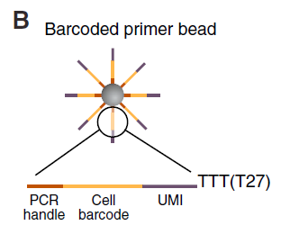
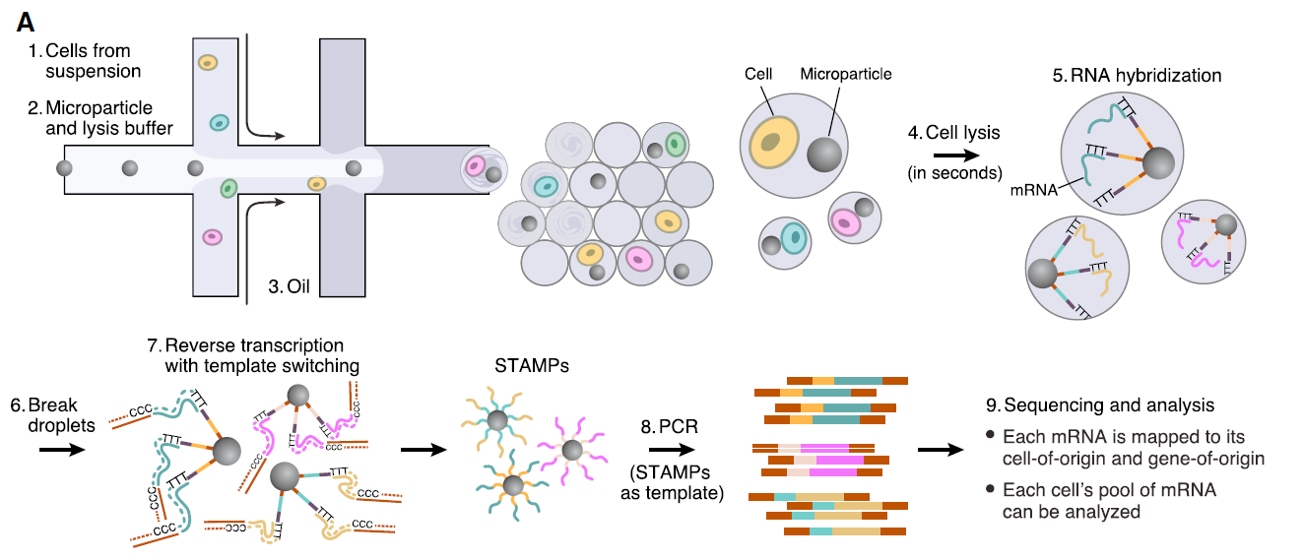
RNA-Seq using Drop-Seq
Minimum infrastructure required
Cost effective
Single cell resolution
Macosko et al. Highly Parallel Genome-Wide Expression Profiling of individual Cells Using Nanoliter Droplets. Cell 2015.

Slide 3
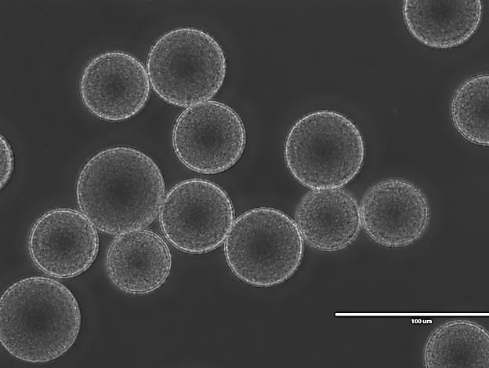
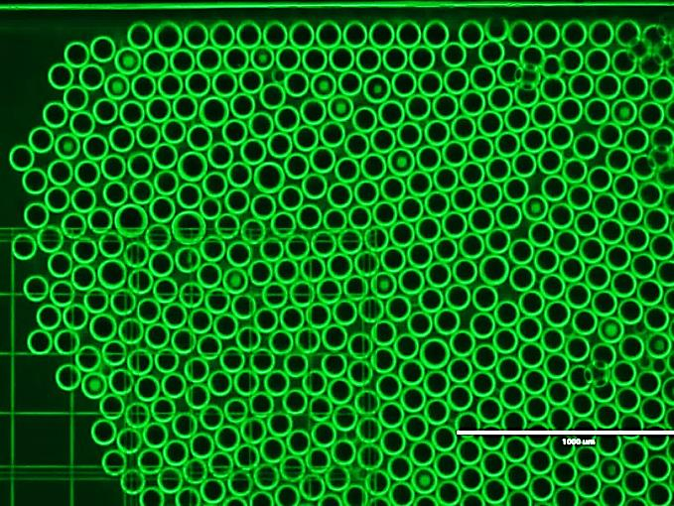
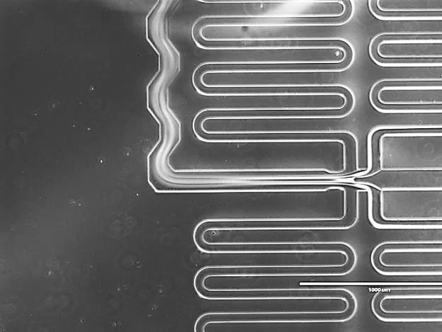
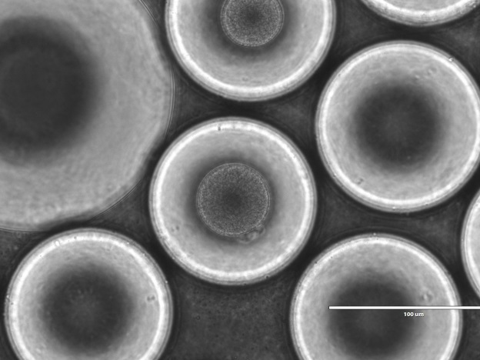
Drop-seq Workflow: From cells & beads to droplets
Barcoded Beads
Determination of occupancy (5%)
Droplet Formation
Reverse transcription
Exonuclease treatment
PCR amplification
Encapsulated Beads
Tagmentation (library preparation)
Sequencing
100 um

Slide 4
RNA-DNA Hybrid
AAAA
5’
mRNA
TTTT
3’
PCR Handle
Cell Barcode
UMI
+ Reverse Transcriptase
AAAA
5’
RT
TTTT
CCC
3’
+ Template Switch Oligo
GGG
GAA
5’
AAAA
TTTT
CCC
+ Reverse Transcriptase
AAAA
GGG
GAA
5’
RT
TTTT
CCC
CTTCCC
3’
Known handle
cDNA
Known handle

Slide 5
AAAA
GGG
GAA
5’
TTTT
CCC
CTTCCC
3’
Known handle
cDNA
Known handle
+ Exonuclease I
TTTT
CCC
CTTCCC
3’
PCR Amplification
n
Fragmentation by Transposases
Tagging & PCR
Tagging & PCR

Slide 6
Paired-end Next-Gen Sequencing Determines Cell Identity, Molecule Quantity & ID
Index 1
PCR handle
5’ AATGATACGGCGACCACCGAGATCTACACGCCTGTCCGCGGAAGCAGTGGTATCAACGCAGAGTACACGTACGTACGTGCATGCAT(TTTTT)₆TTCAATTAATA --– 3’
Cell #1
Molecule #1
Read #1
Read #2
3’ TTACTATGCCGCTGGTGGCTCTAGATGTGCGGACAGGCGCCTTCGTCACCATAGTTGCGTCTCATGTGTG
CATGCATGCACGTACGTA(AAAAA)₆AAGTTAATTATGGCTCGGGTGCTCTGATTCCGCTTAGAGCATACG
GCAGAAGACGAAC– 5’
Albumin gene
Index 2

Slide 7
Bioinformatic Analysis: Using barcodes, UMIs, and Genes
Cell #1
Cell #2
Proceed to
Matrix Generation
Cell #3
Cell #4

Slide 8
Generation of a Digital Expression
Matrix to Deconvolute Populations
 | Cell #1 | Cell #2 | Cell #3 | Cell #4
Albumin | 3 | 3 | 4 | 3
GATA2 | 3 | 0 | 3 | 10
DNMT2B | 2 | 2 | 2 | 5
PCA2 (DNMT2B)
PCA1 (GATA2)

Slide 9
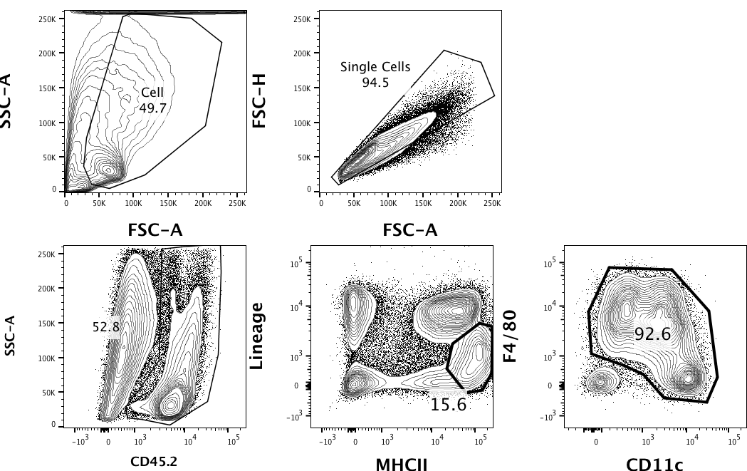
CD45+ Cell Isolation from Mouse Colon
Cell isolation from Steady-state WT colon
Cells were stained with CITEseq antibodies prior to FACs sorting.
Single cell analysis
Droplet based scRNAseq
Sequencing By NextSeq500
NIAID Genomic Technologies Section
Generated cDNA & cDNA library
Sort the cells into 10x Chromium
- Collected about 6500 cells

Slide 10
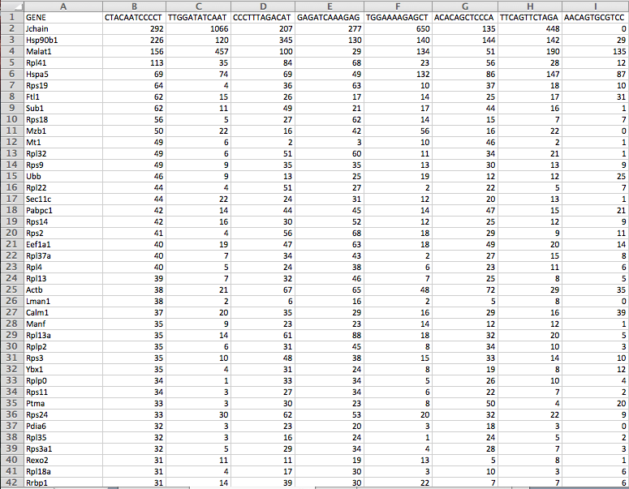
After Primary Analysis
Example of Dropseq Gene Table
Generation of Gene Matrix Table using CellRanger in Biowulf
Any available R or python packages for scRNAseq analysis
Genes x Cell.ids

Slide 12
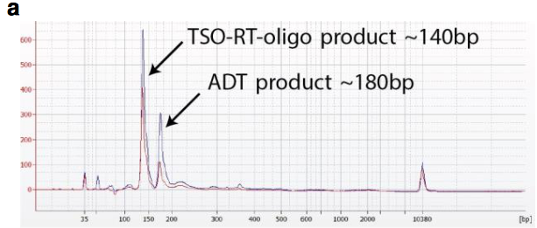
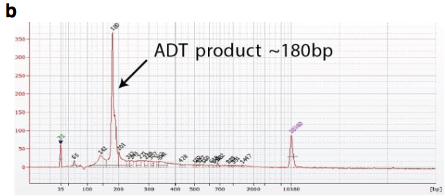
CITE-Seq / Total-Seq

Slide 13
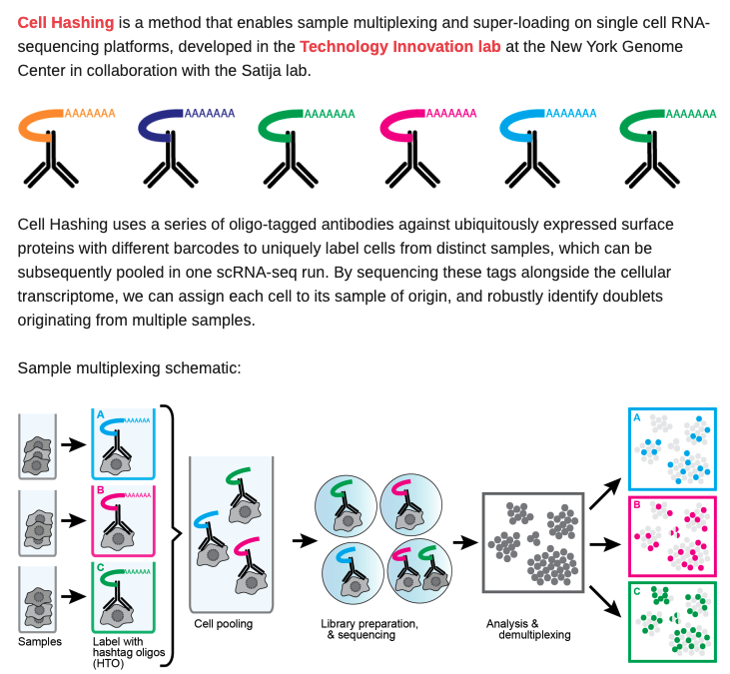
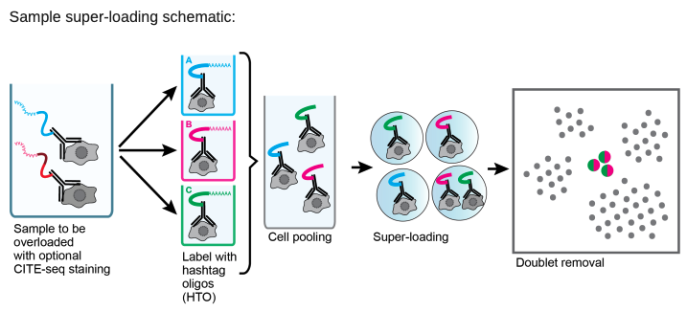
Super loading is possible due to increased accuracy of doublets removal.
Minimize batch effect (we don’t need any batch effect removal step)
Biological replicates → enhance statistical power

Slide 14
Water Control
DSS-Day 8

